Slide 1
Homeless Emergency Aid Program (HEAP)
February 28, 2019
1:00-3:00
Mandatory Bidders Conference

Slide 2
Presented By
Katherine Thoeni, Executive Officer/Coalition of Homeless Services Providers
Administrative Entity/HEAP Program

Slide 3

First Things First
Let’s go around the room for introductions. Name and Agency or Affiliation Please.

Slide 4
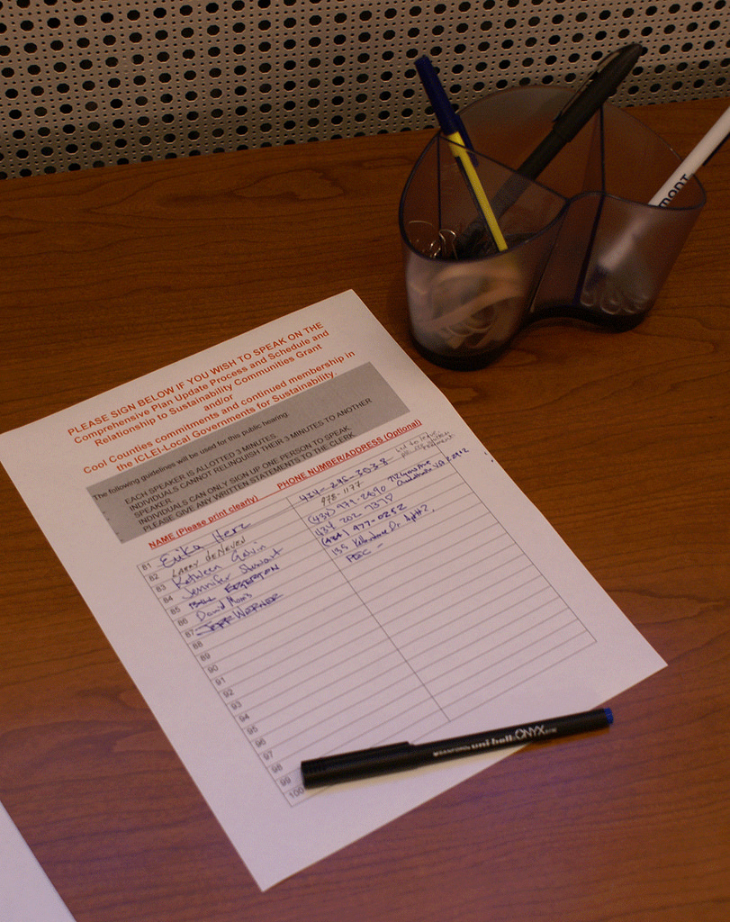
Sign In & Stay
Please make sure that you complete the sign in sheet. If you don’t sign in, you are not considered present.
HEAP proposals received from organizations that did not attend today’s session, did not sign in, or left prematurely, will not be considered for funding or eligible for the appeal process.

Slide 5
Goals for the Session
Review NOFA
HEAP Program description
Administrator
Calendar
Eligible Applicants
Available Funds
Expenditure of HEAP Funds
Definitions
Other program requirements
Reallocation of funds
Project selection process
Appeals process
Contracts
Reporting
Billing

Slide 6

When to Ask Questions
There will be time for questions between each broad section.
Please hold your questions until we reach the end of each section.
Thank you.

Slide 7

NOFA & Project Application Can Be Obtained At:
chspmontereycounty.org in the CoC Funding/HEAP section

Slide 8
NOFA Review-HEAP Program Description
The Leadership Council, which serves as the Continuum of Care (CoC) Board, is pleased to announce the availability of Homeless Emergency Aid Program (HEAP) grant funding. HEAP is a block grant program designed to provide immediate and direct assistance to those impacted by the homeless crisis in Monterey or San Benito Counties. HEAP funding is intended to provide funding to deliver immediate assistance to homeless persons within the CoC. The HEAP statute mandates that 50 percent of the awarded funds must be contractually obligated by January 1, 2020. Additionally, 100 percent of the funds must be expended by June 30, 2021.
Eligible activities include, but are not limited to: expansion of homeless bed inventory through new emergency shelters, warming shelters, transitional or other housing; operating and/or supportive services for new homeless beds; rental assistance, rapid rehousing, eviction prevention and/or move-in assistance; street outreach programs, health and safety education services and criminal justice diversion programs; housing navigation, landlord mitigation programs, targeted case management and other related activities

Slide 9
Shelter Crisis Declarations
The shelter crisis declaration pursuant to Chapter 7.8 (commencing with Section 8698) of Division 1 of Title 2 of the Government Code is required for all cities and counties that wish to have HEAP funded projects in their jurisdiction or unincorporated area. Jurisdictions or unincorporated areas that do not declare a shelter crisis may be able to have certain HEAP funded services in their geographic areas such as street outreach or housing navigation services, but will not be eligible for capital (construction, rehab, acquisition) projects.
Approved Shelter Crisis Declarations by Jurisdiction
Marina, Monterey, Salinas, Hollister, King City, Monterey County, San Juan Bautista, Sand City, San Benito County, Seaside

Slide 10

NOFA Review-Administrator
The administrator of the funds is an “Administrative Entity (AE)” An AE means an entity that has previously administered Department of Housing and Urban Development Continuum of Care funds as the collaborative applicant pursuant to Section 578.3 of Title 24 of the Code of Federal Regulations that has been designated by the Continuum of Care to administer program funds. The Leadership Council has designated the Coalition of Homeless Services Providers (CHSP) to serve as Administrative Entity for the HEAP program.

Slide 11

NOFA Review-Firm Timelines and Deadlines
2/8/19- NOFA & Application Released
2/8/19-2/27/19- Public Notice Period
2/28/19- Mandatory Bidders Conference
4/1/19-Project Applications Due

Slide 12

NOFA Review-Estimated Timelines
Week of 4/8/19-Rank/Review Panel convened
Mid to Late April-Leadership Council selects and approves projects
Month of May-Contract negotiations
June-Contracts executed
**These timelines subject to adjustment and/or modifications

Slide 13
NOFA Review-Eligible Applicants
Applicant must meet all licensing requirements that apply to its organization. Applicant must license, report and pay taxes to the State or Local Business License Entity, if they are required by the laws of those jurisdictions;
Applicant must have a Federal Tax ID number/employer identification number (EIN) to facilitate payments;
The applicant’s status as a legal entity must be in good standing and must not have been revoked in the previous 3 calendar years;
Applicant must be incorporated as a private non-profit corporation by the State of California and must have been granted a 501 (c) (3) tax exempt status by the United States Internal Revenue Service, the applicant’s tax exempt status must be in good standing and must not have been revoked in the previous calendar year, OR;
Applicant is a federally-recognized Indian tribe in the State of California, OR;
Applicant is a jurisdiction, public department or agency or public corporation, commission, or other legal entity.

Slide 14
NOFA Review-Available Funds
Monterey County
$1,008,888 Available for Service Related Projects (10% of available funding)
$1,008,888 Available for Rental Assistance/Subsidies/Rapid-Rehousing Projects
(10% of available funding)
$6,505,777 Available for Capital Projects (65% of available funding)
$1,008,888 Unaccompanied Homeless Youth (10% of available funding. May be a service related project, rental assistance/subsidy or capital project)
$ 500,445 Category 3 Homeless Youth (maximum of 5% of available funding. May be a service related project, rental assistance/subsidy or capital project)
$10,008,889 Total Funds Available for Monterey County Projects

Slide 15
NOFA Review-Available Funds
San Benito County
$1,315,435 Available for Service Related Projects (70% of available funding)
$ 75,000 Available for Rental Assistance/Subsidies/Rapid-Rehousing Projects
(4% of available funding)
$ 200,000 Available for Capital Projects (11% of available funding)
$ 187,109 Unaccompanied Homeless Youth (10% of available funding. May be a service related project, rental assistance/subsidy or capital project)
$ 93,554 Category 3 Homeless Youth (maximum of 5% of available funding. May be a service related project, rental assistance/subsidy or capital project)
$1,871,098 Total Funds Available for San Benito County Projects

Slide 16

NOFA Review-Additional Funding Information
A minimum of 10% of available HEAP funds must be used to establish or expand services meeting the needs of unaccompanied homeless youth (18-24)
A maximum of 5% of available HEAP funds may be used to establish or expand services meeting the needs of families with dependent minors who have experienced a long term period without living independently in permanent housing, have experienced persistent instability as measured by frequent moves over such period or doubled/tripled up. This is known as Category 3 homeless under other federal statutes. It is important to understand that funding to this population is not guaranteed and is an option only.

Slide 17

NOFA Review-Expenditure of HEAP Funds
HEAP statutes mandates that 50% of the awarded funds must be contractually obligated by January 1, 2020. 100% of the funds must be expended by June 30, 2021. No contract extensions will be provided. No renewals will be available. HEAP funds are to be considered “One-Time Only”.
Proposed program/project budgets should be calculated as a 24-month budget

Slide 18

NOFA Review-Matching Requirement
Matching funds are not required for HEAP funding. However, proposed projects should be prepared to document additional funding sources secured or proposed for the overall project.

Slide 19
NOFA Review: Eligible Activities
Services
Street outreach, health & safety programs, criminal justice diversion prevention services, housing navigation (without financial assistance attached), supportive services for new homeless beds or other related activities.
Rental Assistance/Subsidies/Rapid-Rehousing
Housing identification/navigation combined with rental assistance/subsidies/rapid-rehousing, move-in assistance, rental assistance, rapid rehousing, landlord mitigation programs and other related activities.

Slide 20

NOFA Review: Eligible Activities
Capital
Acquisition, rehabilitation, construction or long-term leasing. May be used to develop new emergency shelter, warming shelter, transitional, permanent supportive or other related activities.
*Remember, Capital projects are only allowed in communities that declared an emergency shelter crisis.

Slide 21
NOFA Review: Homeless Definitions
Literally Homeless
Has been residing in a public or private place not designed for, or ordinarily used as a regular sleeping accommodation for human beings such as vehicles, abandoned buildings, the street, parks, transit stations, etc.
Congregate shelters, hotels/motels (if paid for by a program) or transitional housing
Is existing an institution where he or she resided 90 days or less and prior to admission resided in a shelter, hotel/motel or transitional housing.

Slide 22
NOFA Review-Homeless Definitions
Imminent Risk of Homelessness
Loss of primary nighttime residence within 14 days of the application for assistance. Verified via documentation
Certification that no subsequent residence is identified
Documentation of a lack of resources or support networks needed to obtain other permanent housing

Slide 23
NOFA Review-Homeless Definition
Fleeing Domestic Violence
Certification that he/she or the family is actively fleeing domestic violence, sexual assault, stalking, trafficking, or other life-threatening conditions related to violence , that no other residence is available and the household lacks resources and support networks needed to obtain housing.

Slide 24
NOFA Review-Homeless Definition
Homeless Under Other Federal Statutes
Homeless families and youth who have experienced a long-term period without living independently in permanent housing, doubled/tripled up, etc. This is knows as Category 3. Projects submitted for this population may be considered for funding, but is not guaranteed.

Slide 25
NOFA Review-Other Requirements
Housing First/Low Barrier
All HEAP Funded projects must adhere to Housing First principals. Few to no prerequisites such as sobriety or completion of treatment programs, screen in rather than screen out those with barriers such as no or very low income, poor rental history or criminal histories. Supportive services are voluntary.

Slide 26

NOFA Review-Homeless Management Information Systems (HMIS)
All HEAP funded projects are required to participate in the local HMIS program and comply with HMIS related policies and procedures. HEAP funded projects are responsible or the costs incurred in HMIS participation. HMIS costs may only be applied to the indirect line item of proposed budgets.

Slide 27

NOFA Review-Indirect Costs
Projects that intend to charge indirect costs must clearly state in the project application the rate of distribution base the project intends to use. A letter or other documentation must be provided if the applicant has a federally negotiated indirect cost rate. Otherwise, a maximum of 10% of HEAP funding may be targeted to indirect costs.

Slide 28

NOFA Review-Coordinated Entry System
All HEAP funded transitional, permanent, permanent supportive and rapid rehousing projects must only accept homeless participants for program enrollment through the local Coordinated Entry System.
HEAP funded projects are responsible for ensuring appropriate staff attend Coordinated Entry System trainings.

Slide 29

NOFA Review-Program Participant Rents
HEAP funded transitional, permanent supportive or other permanent housing are required to have signed occupancy agreements and may charge a maximum of 30% of the participants adjusted monthly income; or 10% of the households total monthly income; or, the amount the household is receiving payments for welfare assistance from a public agency and a part of the payment is designated to meet housing costs.

Slide 30

NOFA Review-Deed Restrictions
Capital Projects Only
HEAP funded capital projects will require a 10- year deed restriction. This requirement may be waived if the project can document that it is already under a deed restriction from another funding source for a time frame that meets or exceeds the 10-year period.

Slide 31

NOFA Review-Site Control & Zoning/Permitting
Capital Projects Only
Applicants must demonstrate site control for capital projects.
Applicants must demonstrate zoning /permitting approval for capital projects or describe the intended process to obtain approvals.

Slide 32

NOFA Review-Community Support
Capital Projects Only
Applicants must provide documentation of community support for capital projects.

Slide 33

NOFA Review-Prevailing Wage
Capital Projects Only
HEAP funds are considered public funds and will trigger prevailing wage requirements. Prevailing wage requirements will be waived only in the event that the applicant is able to clearly document a legal reason for waiver. It is recommended that the applicant consult with an attorney and/or the Department of Industrial Relations to make a final determination on paying state prevailing wages.

Slide 34

Let’s Pause For A Moment
We’ll go back to the NOFA in a little while.
For now, any questions on what has been covered so far?
Then we will move on to the actual application.

Slide 35

Application-General Information
Basic Contact Information (page 1)-Only needs to be completed once.
Summary of Project Proposal Information (page 2) –Complete one box for each proposed project.
General Applicant Information-Only needs to be completed once. Please be specific, but concise when answering the questions.

Slide 36
Project Narrative-Services
Only complete this narrative section if applying for homeless services funding. Leave this entire section blank if funding for services is not being sought.
Please be specific, but concise, when answering questions.
Be aware of page limit(s)
Narrative Sections
Project Overview & Population
Program Description
Budget
Goals and Outcomes
Past Performance and Data Collection
Attachments (attachments are not included in page limits)
Questions on the Services Narrative?

Slide 37
Project Narrative-Rental Assistance or Subsidy
Only complete this narrative section if applying for rental assistance or subsidy funding. Leave this entire section blank if funding for rental assistance/subsidies is not being sought.
Please be specific, but concise, when answering questions.
Be aware of page limit(s)
Narrative Sections
Project Overview & Population
Program Description
Budget
Goals and Outcomes
Past Performance and Data Collection
Attachments (attachments are not included in page limits)
Questions on the Rental Assistance/Subsidy Narrative?

Slide 38
Project Narrative-Capital
Only complete this narrative section if applying for capital funding. Leave this entire section blank if funding for capital is not being sought.
Please be specific, but concise, when answering questions.
Remember deed restrictions, pay particular attention to sustainability and supportive service items.
Document clear milestones
Be aware of page limit(s)
Narrative Sections
Project Overview & Population
Program Description
Budget
Goals and Outcomes
Past Performance and Data Collection
Attachments (attachments are not included in page limits)
Questions on the Capital Narrative?

Slide 39

Attachments-Budget Forms
Note: Two different budget forms.
One for Services and Rental Assistance/Subsidy Projects
One for Capital Projects
Questions about budget forms?

Slide 40
Other Attachments
Completed budget narrative for each proposed project
Agency budget for 2018-2019. Departmental or program budget for City/County applicants
Board of Directors roster with affiliations. Waived for City/County applicants.
Verification of legal entity status
Statement of Financial Position & Statement of Activities for most recently completed fiscal year. Waived for City/County applicants.
Copy of agency’s most recent 990 or equivalent
Most recent independent audit report. Waived for City/County applicants
Organizational chart
Job descriptions for any HEAP funded positions
Federally approved indirect rate if applicable
Site control for Capital projects only
Deed restriction waiver documentation for Capital projects if applicable
Prevailing wage waiver documentation for Capital projects if applicable
Zoning and permitting approval documentation for Capital projects if applicable
Documentation of community support for Capital projects
Design sketches for Capital projects if applicable

Slide 41
Application Submission Method
Completed application and all required attachments to be submitted in PDF format via email to chspmontry@aol.com. Include “HEAP APPLICATION” in subject line. Application may also be submitted in hardcopy, but must be hand delivered to the Coalition of Homeless Services Providers office located at 220 12th Street, Marina. Hard copied applications should be placed in a manila envelope clearly labeled “HEAP Application.”
All applications are due by 5:00 p.m. on April 1, 2019.

Slide 42

Application Questions

Slide 43

Project Selection
This RFP is competitive. Applications not meeting minimum eligibility, completeness, or submission deadline will not be considered for funding. They will also not be eligible for appeal.
Applications will be rated using a 120 point scoring system based upon information provided per section in the application.

Slide 44
Project Selection
The Administrative Entity will convene an objective Rating Panel who will review and score applications.
Rating Panel will prepare funding recommendations and submit to the Leadership Council.
The Leadership Council will make final decisions regarding project selection.
Notice of awards will be sent to the designated contact person for each applying organizations by the Administrative Entity following final project selection approvals.

Slide 45

Right to Reserve
Projects, scopes of work, percentage allocations and budgets are subject to modification and/or negotiation based upon Leadership Council direction.
The Leadership Council also reserves all rights not expressly stated in the RFP, including making no awards, awarding partial funding, or increasing funding based on budget availability, and negotiating with any proposer regarding the funding amount and other terms of any contract.

Slide 46

Questions
Questions about project selection?

Slide 47

Appeal Process
An applicant may appeal if the application was not approved for funding and can show, with evidence, that they were directly aggrieved in connection with the proposal process or award of contracts.
Applications that were not received by the required due date or did not meet threshold requirements are not eligible for appeal.
Applicants that did not participate in the mandatory Bidders Conference are not eligible for appeal.
Appeals cannot be based upon the judgement of the Ratings Panel.

Slide 48
Appeal Process
Appeals must be received in writing within 3 business days of the project selection announcement.
The appeal is limited to one single spaced page in 12-point font.
Appeals must be based on the information submitted on the application. No additional information will be considered. Omissions to the application cannot be appealed.
The Appeals Committee will review only those areas of the application that are being appealed.
Applicants appealing will be invited to make a 10-minute statement to the Appeals Committee.
The Appeals Committee will review the Rating Panel recommendation or Leadership Council decision only on the basis of the submitted project application, the one page appeal, any statements made during the appeal process, and any material used by the Rating Panel.
The decision of the Appeals Committee must be supported by a simple majority vote.
The appealing organization will receive the written decision of the Appeals Committee within 2 business days of the Appeals Committee meeting .
The decision of the Appeals Committee is final.

Slide 49

Questions
Regarding the Appeal Process?

Slide 50
Contracting
Approved projects will be contacted by the Administrative Entity to enter into contract negotiations. The following will be reviewed during the negotiation process:
-Specific scopes of work
-Overview of budget, invoicing and reporting requirements
The Administrative Entity will utilize information from the negotiation process to formalize contracts for execution.
Projects will not be paid for activities conducted prior to the final contract execution.

Slide 51

Questions
Questions about contracting?

Slide 52

Billing
HEAP funded projects will provide billing invoices with associated documentation to the Administrative Entity by the 10th day of the month for expenses incurred for the previous month.
If billing information is complete and received in a timely manner, payment will be made within a minimum of 30 and maximum of 60 days.
Capital project billing and payment may be directly tied to milestone accomplishment. This will be included within the contract negotiation process.

Slide 53

Questions
Questions about billing?

Slide 54

Reporting
Strict guidelines are mandated by HEAP related to project financial expenditures.
Rigorous project reporting and monitoring will ensure HEAP funded programs are not under-performing.
In addition to monthly financial billing, quarterly reports related to program outcomes are required. In-person on-site monitoring will be conducted every 6 months or more if project is not meeting outcomes.

Slide 55

Questions
Questions about reporting?

Slide 56

Reallocation
The Leadership Council reserves the right to reallocate funds if the project is determined to be underperforming or not expending funds in the required manner.

Slide 57

Official Content Concluded
Any other questions?

Slide 58

Thank You
Thank you for your time and attention.
Good Luck!

